Slide 1
Basic Electrical and Electronics Engineering
LECTURE 3.1
Dr. Sonam Shrivastava/ Assistant Professor (Sr.) /SELECT

Slide 2
BEEE102L
Basic Electrical and Electronics Engineering
DC Circuits
AC Circuits
Magnetic Circuits
Electrical Machines
Semiconductor Devices and Applications
Digital Systems

Slide 3
Books
Text Books
Allan R. Hambley, “Electrical Engineering -Principles & Applications”, 2019, 6th Edition, Pearson Education
V. D. Toro, Electrical Engineering Fundamentals, 2nd edition. PHI, 2014
Reference Books
R. L. Boylestad and L. Nashelsky, Electronic Devices and Circuit Theory, 11th edition. Pearson, 2012
DP Kothari & Nagrath, “Basic Electric Engineering”, 2019, Tata McGraw Hill

Slide 4
Module 3. Magnetic Circuits
Magnetic field; Toroidal core: Flux density, Flux linkage;
Magnetic circuit with air gap;
Reluctance in series and parallel circuits;
Electromagnetic Induction: Self And Mutual
Magnetically Coupled Circuits
Series and Parallel Magnetic Circuits
Dot Convention

Slide 5
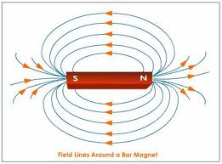
Introduction
Magnetic lines of force:
Closed path radiating from north pole, passes through the surrounding, terminates at south pole and is from south to north pole within the body of the magnet. (Flux)
Properties:
Each line forms a closed loop and never intersect each other.
Lines are like stretched elastic cords.
Lines of force which are parallel and in the same direction repel each other.

Slide 6
Introduction
Magnetic Field
The space around which magnetic lines of force (flux) act.
Strong near the magnet and weakens at points away from the magnet.

Slide 7
Introduction
Magnetic Materials
Properties:
Points in the direction of geometric north and south pole when suspended freely and attracts iron fillings.
Classification :
Natural Magnets
Temporary magnets (exhibits these properties when subjected to external force)
Non-magnetic materials.

Slide 8
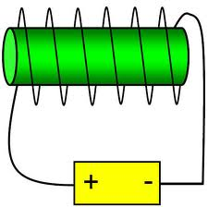
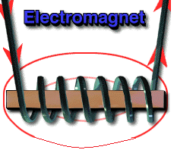
Introduction
Electromagnets:
Principle: An electric current flowing in a conductor creates a magnetic field around it.
N
Strength of the field is proportional to the amount of current in the coil.
The field disappears when the current is turned off.
A simple electromagnet consists of a coil of insulated wire wrapped around an iron core.
Widely used as components of motors, generators, relays etc.
I

Slide 9
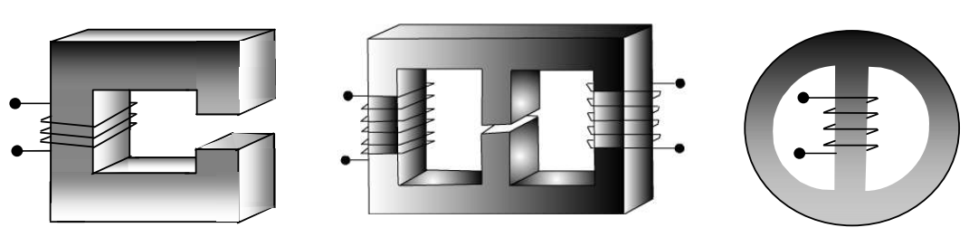
Magnetic circuit
Magnetic Materials of regular geometric shape is called core.
A Coil having N numbers of turns are wound over the core.
If current flows in the coil magnetic flux will be produced in the core.

Slide 10
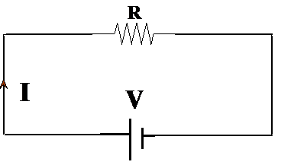
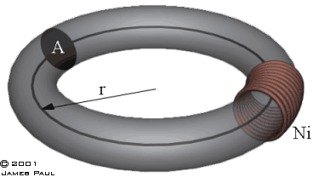
Magnetic circuit
The complete closed path followed by any group of magnetic lines of flux
Equivalent electrical circuit

Slide 11
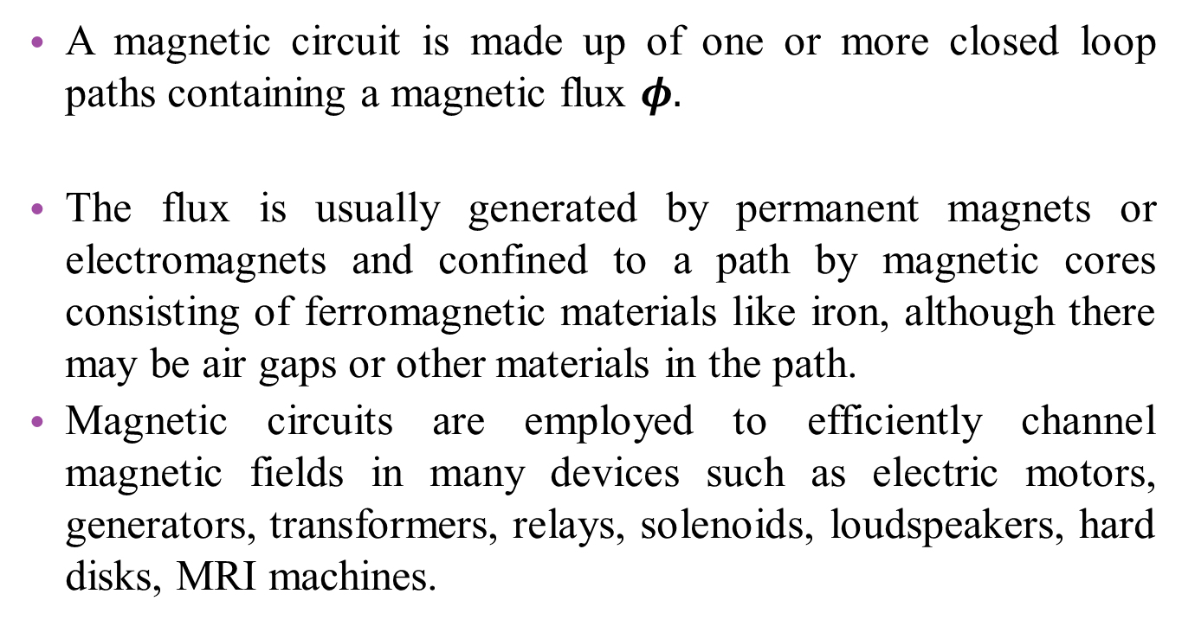
Introduction
A magnetic circuit is made up of one or more closed loop paths containing a magnetic flux $φ.$
The flux is usually generated by permanent magnets or electromagnets and confined to a path by magnetic cores consisting of ferromagnetic materials like iron, although there may be air gaps or other materials in the path.
Magnetic circuits are employed to efficiently channel magnetic fields in many devices such as electric motors, generators, transformers, relays, solenoids, loudspeakers, hard disks, MRI machines.

Slide 12
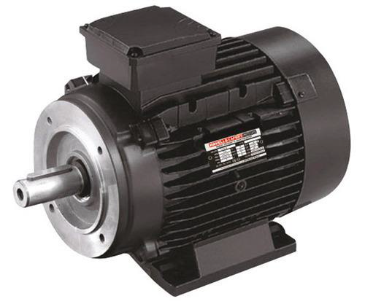
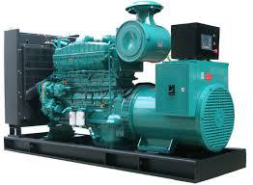
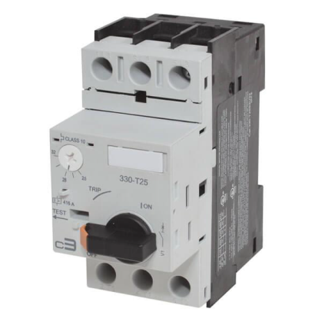
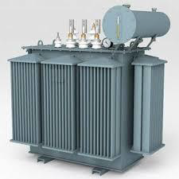
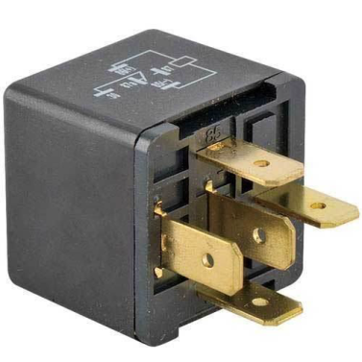
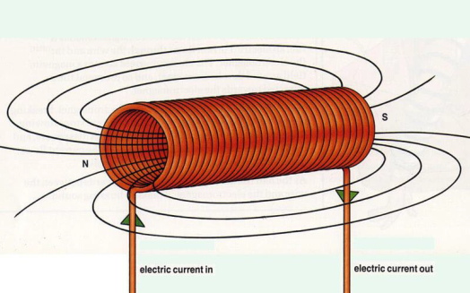
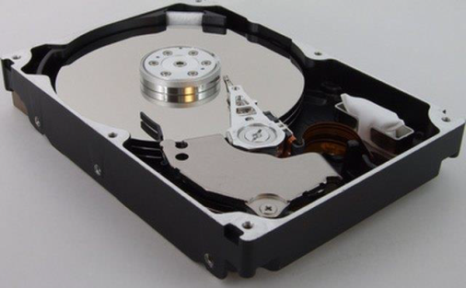
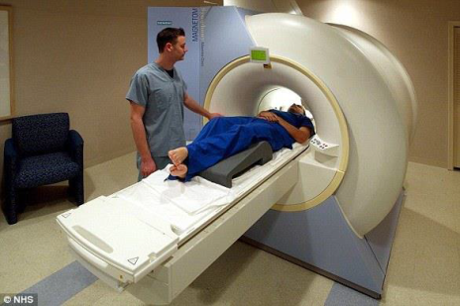
APPLICATIONS
Motors
Generators
Transformers
Circuit Breakers
Relay Switches
Solenoids
Hard Disks
MRI Machines

Slide 13
Basic Definitions

Slide 14
Magneto Motive Force (MMF)
In an electric circuit, the current is induced due to the existence of an electromotive force (emf E, battery voltage). By analogy, we say that in a magnetic circuit the magnetic flux is induced due to the existence of a magneto motive force (mmf F) caused by a current flowing through one or more turns of coil.
Force which drives the magnetic lines of flux through a magnetic circuit
MMF, F = ΦS, where ‘Φ’ is the magnetic flux and ‘S’ is the Reluctance of the magnetic path.
Also, For Electromagnets:
where N is the number of turns of the coil and I is the current flowing in the coil
Unit: AT (Ampere Turns)
MMF= N I (No. of turns*Current),
Analogy: EMF, V=IR

Slide 15
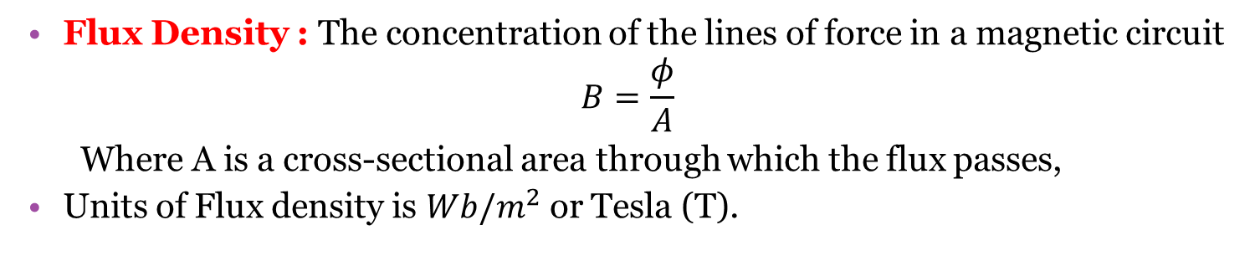
Magnetic flux (Φ):
Magnetic flux is a measurement of the total magnetic field which passes through a given area
Number of magnetic lines of force created in a magnetic circuit.
Unit : Weber (Wb)
Analogy: Electric Current, I
Flux Density (B):
Flux Density : The concentration of the lines of force in a magnetic circuit
$$B=\frac{φ}{A}$$
Where A is a cross-sectional area through which the flux passes,
Units of Flux density is $Wb/m^{2}$ or Tesla (T).
Analogy: Current Density

Slide 16
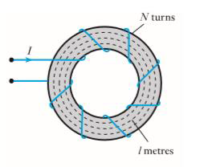
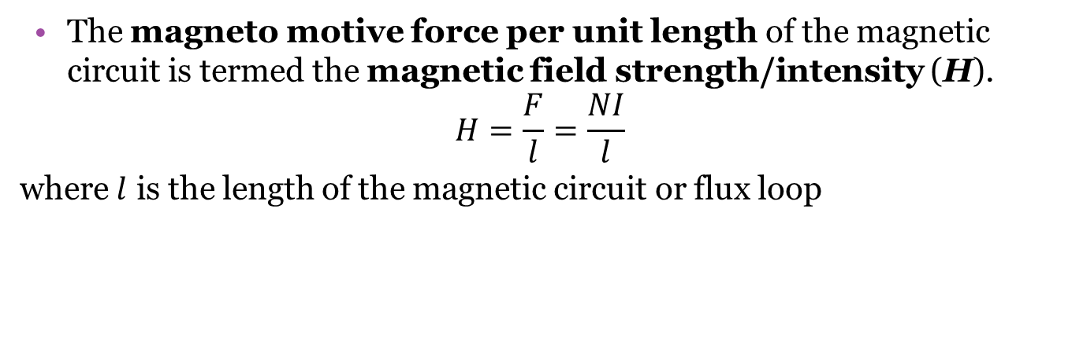
Magnetic field strength/intensity (H)
The magneto motive force per unit length of the magnetic circuit is termed the magnetic field strength/intensity (H).
$$H=\frac{F}{l}=\frac{NI}{l}$$
where $l$ is the length of the magnetic circuit or flux loop
Units of H are ampere-turns per meter (At/m) or just ampere per meter (A/m)
Analogy: Electric field strength

Slide 17
Permeability (µ)
A property of a magnetic material which indicates the ability of magnetic circuit to carry magnetic flux.
μ = B / H
Unit: Henry / meter
Permeability of free space or air or non magnetic material μ₀=4*Π*10⁻⁷ Henry/m

Slide 18
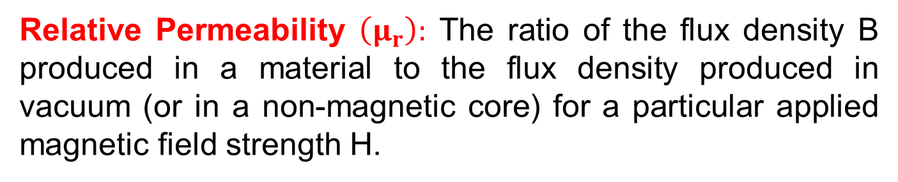
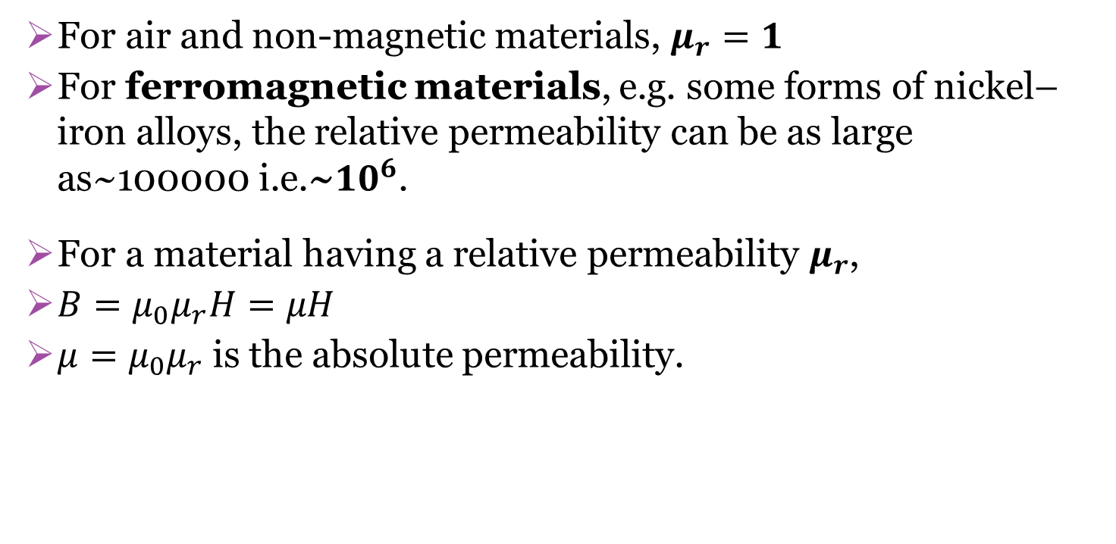
Relative Permeability
Relative Permeability $\left(μ_{r}\right):$ The ratio of the flux density B produced in a material to the flux density produced in vacuum (or in a non-magnetic core) for a particular applied magnetic field strength H.
For air and non-magnetic materials, $μ_{r}=1$
For ferromagnetic materials, e.g. some forms of nickel–iron alloys, the relative permeability can be as large as~100000 i.e.~${10}^{6}$.
For a material having a relative permeability $μ_{r}$,
$B=μ_{0}μ_{r}H=μH$
$μ=μ_{0}μ_{r}$is the absolute permeability.

Slide 19
Reluctance
Reluctance: It is the opposition that a magnetic circuit offers to the passage of magnetic flux through it (ratio of mmf applied to the flux induced).
The inverse of reluctance is known as permeance (ease of flux passage)
S=F/ɸ
Unit: AT / Wb
Analogy: Resistance

Slide 20
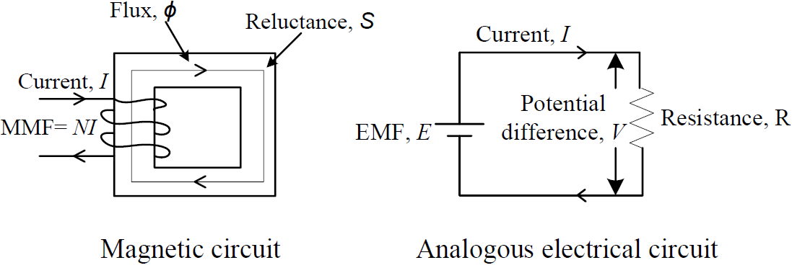
Magnetic Circuit Analogy With Electrical Circuit

Slide 21
Magnetic Circuit Analogy With Electrical Circuit
Similarities:
Electric circuit |  | Magnetic circuit
Quantity | Unit | Quantity | Unit
EMF (E=IR) | Volt (V) | MMF (F=ɸS) | Ampere-turns
Current (I) | Ampere (A) | Flux (ɸ) | Weber (Wb)
Current density (J) | A/ m² | Flux density (B) | Wb / m² or Tesla
Resistance (R) | Ohm (Ω) | Reluctance (S) | Ampere-turns/Wb
Electric field strength (E) | Volts/m | Magnetic field strength (H) | Ampere-turns/m
Conductivity (σ) σ=l/RA | Siemen/m | Permeability, µ µ=l/SA | Henry/m

